Slide 1

CYRUS RETAIL
Security system AND solar solutions

Slide 2
COMPANY PROFILE
Corporate office- Cyrus Electronics Pvt. Ltd. , B44/69, Sector Q, Aliganj, Lucknow, Uttar Pradesh 226024 .
Year of inception - 1986
Employees strength- 200
Company Domain – Security System And Solar Solutions

Slide 3

Cyrus Retail- We have been operating since 1986 in the field of electronic security system including manufacturing, installing and servicing field. We are in security business with one prime motive and that is to provide Efficient, Effective and Economic solution for the need of financial institutions and organizations. Initially the company had started business as a quasi-sign wave generator and later migrated into full scale Electronic security equipment manufacturing field. Later on we felt that the equipment’s manufactured by us needed better after sales service thus we started expanding our business by the way of providing installation and maintenance work.

Slide 4
At present we are serving many banks all over India through our wide spread network service Centre and branch offices of our own. With the help of these we are now able to provide our services to nearly 6000 plus branches of various banks with nearly 4000 + CCTV installations, 6000+ Alarm systems installed by us.
We also undertake maintenance of security equipment’s not installed or manufactured by us, and are fully capable to rectify any problem arising in these devices by the strong back end support of our in house research and development wing.

Slide 5
Our Products-
Currently we are indulge in providing sales, services and maintenance of the following equipment for which the details of its features are attached for your kind review :- • Burglar/Integrated (Fire cum Burglar) Alarm System • Fire Alarm System • Standalone Autodialler • CCTV System • Bio-Metric Access Control System • Flap Barrier

Slide 6
Our Services
In today's scenario after sales services refers to very important processes which make sure that customers are satisfied with the products and services of the organization. We at Cyrus believes in providing the same to our Client. Being a service based industry we always believes in after sales services based industry we always believes in after sales service and annual maintenance services as the base of our company. As you are aware that any security equipment is only effective till it is properly functioning. Now a days Banks have become more sensitive towards the security and tries to put more & best security gadgets for making the security better as well as preventing any hazards within the branch premises. The Gadgets once installed are expected to work 24*7 for effective implementation of the security and in order to make them full functional proper care and maintenance is essential.

Slide 7
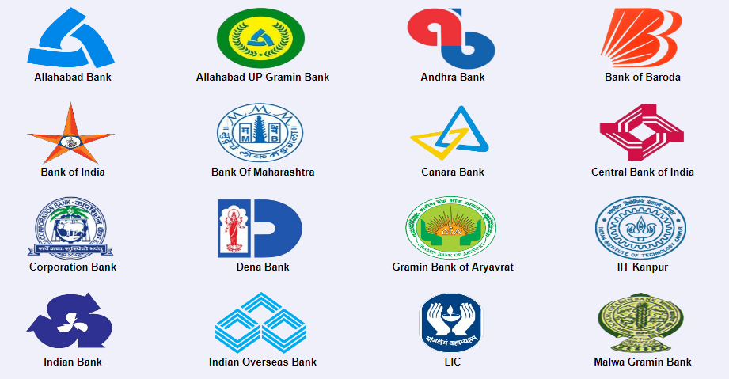
Our Clients

Slide 8
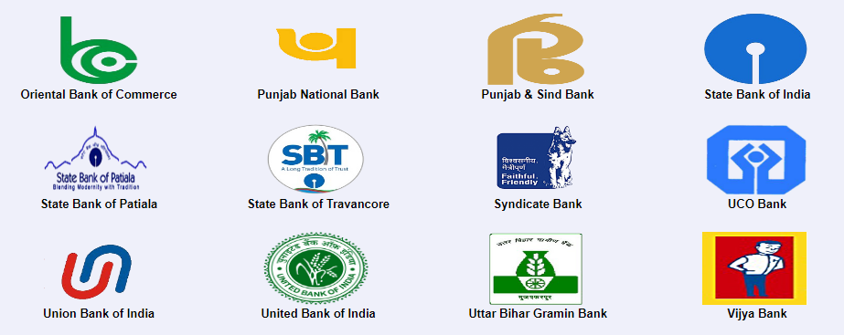

Slide 9
We are hiring for(Job Responsibility)
1- From direct sales segment candidate would be preferred. 2- Set appointments, listen to customer needs and sell most appropriate product 3- Prospecting for new customers through existing leads and cold calling and maximizing lead generation. 4- This is a front-line sales position in the consumer cards sales team, and is responsible for driving business, achieving monthly sales targets and acquiring new customers through direct sales. 5- Ensuring all performance standards are met viz. business targets, controls and compliance. 6- Keep up-to-date on products and competition. 7- Attend and participate in regular staff meetings. 8- Timely execution of all sales activities - leads, campaigns, referrals & any self generated leads.

Slide 10
THANK YOU

